Slide 1
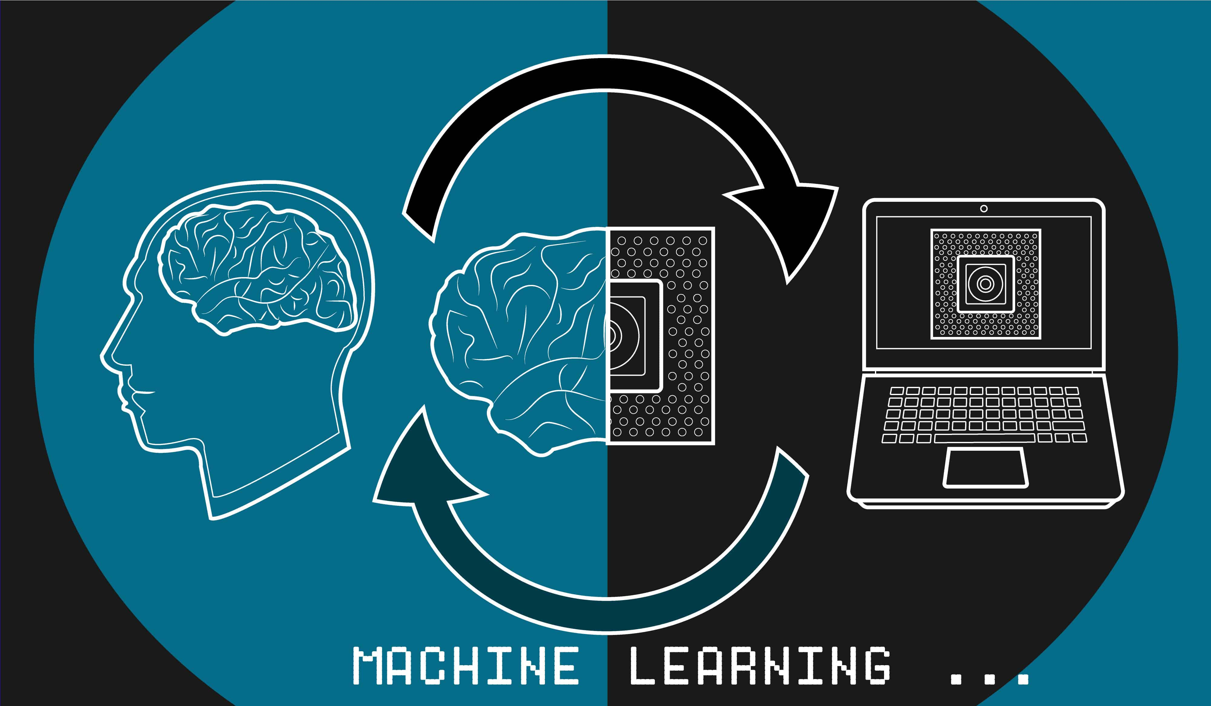
Brain Stroke Prediction Using Machine Learning and Data Science
Batch No. 17 :
17311A1289 – Anil .M
17311A12A7 – Abhinay .L
17311A12A8 – Venkatesh .V
Guide – Ms. N. Sree Vidya

Slide 2

MODEL COMPARISION
Preventive
Measures
Potential Benefits
Solution Process
Key Findings
Recommendation
Problem Overview
AGENDA

Slide 3

Problem Overview
What is the problem?
We will examine who is affected by this problem?
How can we decrease the chances of getting this problem by some preventive measures?
In the next steps we will see how we can use our insights in the business domain.

Slide 4
The Problem is Brain Stroke?
Brain Stroke occurs when a part of brain loses its blood supply and stops working.
It is also called as Cerebrovascular accident.
People with age > 60 are affected more, when compared with age groups of 15-59.
This Problem can be overcome using:
Proper Healthcare Diagnostics
Using Advanced Tech.
Spreading Awareness about the Disease and Treatment.

Slide 5




Solution Process
Model Validation
Model Performance measure on
testing data
Source of the Dataset Kaggle Data repository
The dataset consists of 40000+ Observations with 12 Features including Target variable.
STEP
04
Model Preparation
We teach the model
on Training dataset,
STEP
03
Analytical approach
Supervised Machine Learning problem,
Two class Classification,
STEP
02
Analyse Data
Heterogeneous population, Anomaly Treatment, Missing Values Treatment, creating new variable
STEP
01

Slide 6
MODELS COMPARISION
MODEL 1
(Decision Tree)
MODEL 2
(Logistic Regression)
MODEL 3
(Random Forest)
Training | Testing
78% | 78%
100% | 84%
100% | 75%
100% | 79%
Training | Testing
81% | 82%
100% | 84%
100% | 81%
100% | 82%
Training | Testing
80% | 79%
100% | 76%
100% | 84%
100% | 80%
Accuracy_score
Precision_score
Recall_score
f1_score

Slide 7


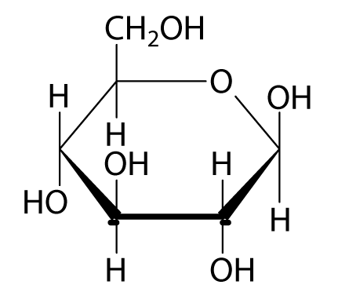





Key Insights
The Most Important features that Influence the Problem.
Ever
Married
Age
Average
Glucose
Level
Gender
B.M.I
Home
Town
Work
Type
Smoking
Status

Slide 8
Avoiding
Hormone
Replacement Therapy for Women.
Proper Healthcare Diagnostic Mechanisms.
Maintaining Proper Health Diet.
Use of Advanced Technology.
Organising Awareness
Camps.
Preventing Measures

Slide 9
Recommendation
Organising Awareness Camps.
Organising Awareness camps Across the small Towns and villages.
Exercise your Body.
The best medicine to cure any disease is to never get one.
Medical Vans.
Setting up medical vans or medical stations for emergency situations on the roads.
Teaching How to handle emergency situations.
Organising Mock drills in the universities and companies to help students and employees cop up with the emergency situation.

Slide 10

Potential Benefits
Reduces the Risk of Getting Any Health Disease
Saves Time and Energy.
Increased Financial Aid for poor.
Probably reduces the Death Rates to some Extent.
Better Social Life

Slide 11
Budget Estimation of Different Countries.
Budget of Different countries on Health Sector Per Person.​
(Except India)​
10000$
7500$
6200$
6000$
5447$
5395$
2.23 Lac Crores
7B $
United States
Switzerland
Norway
Germany
Sweden
Austria
. . . . . . .
India
Malaysia
. . . .
https://www.numbeo.com/health-care/
https://mylifesamovie.com/cheapest-healthcare-in-2020/
https://worldpopulationreview.com/country-rankings/health-care-costs-by-country

Slide 12


Query?

